Slide 1
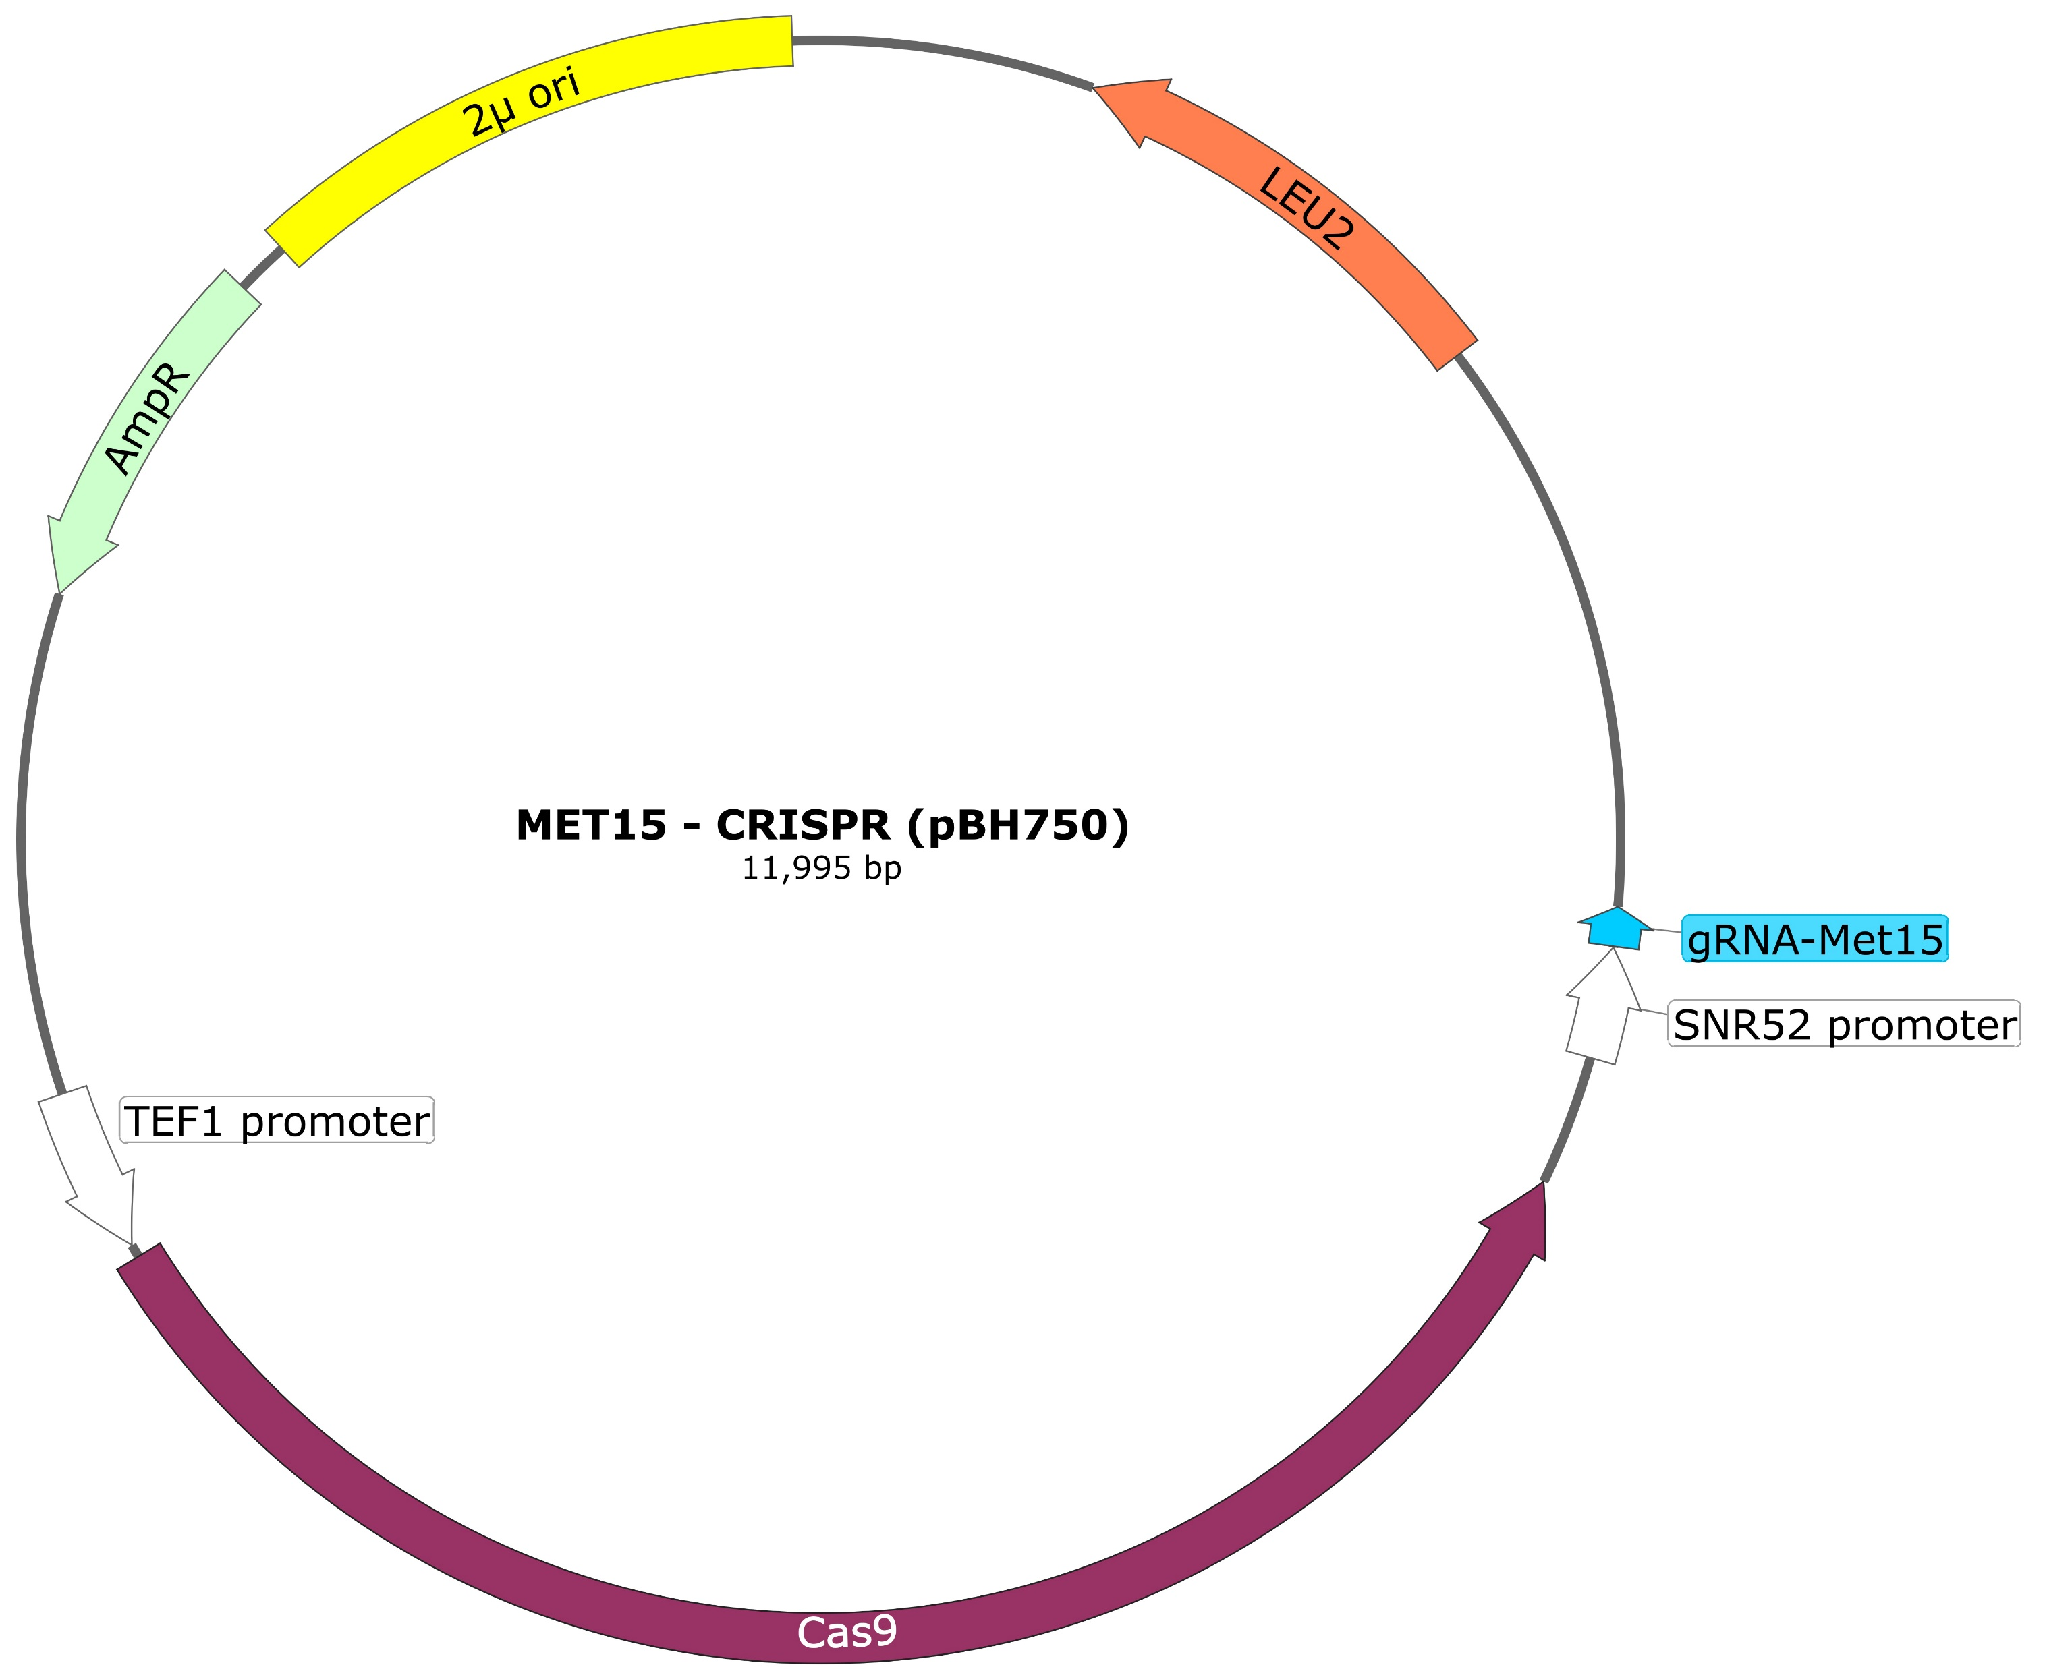
pBH750: CRISPR plasmid

Slide 2
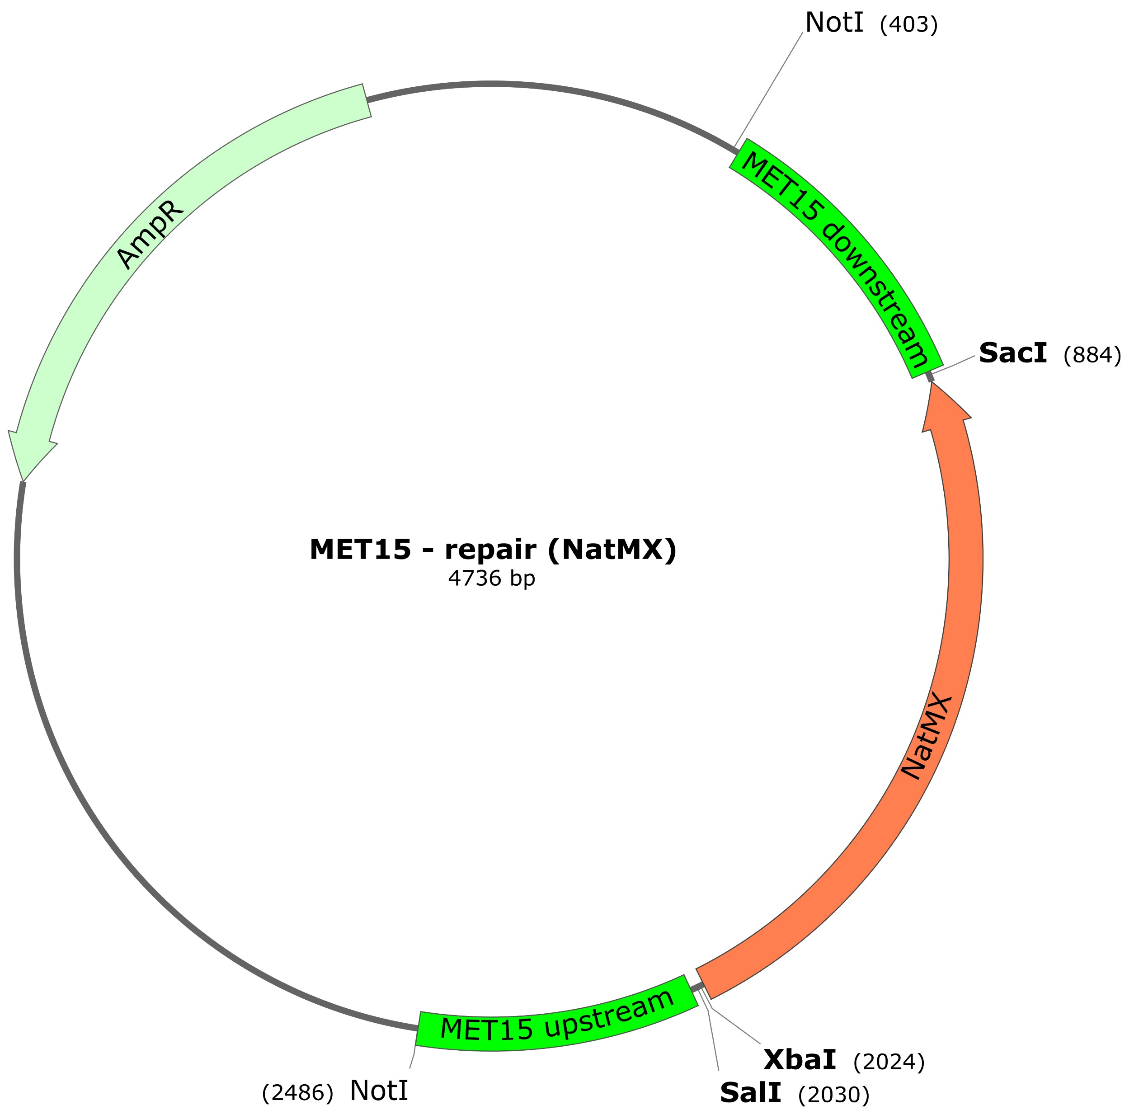
pBH763: Repair template

